Slide 1
Thesis Prospectus
Jiawen Liu
Advised by: Marco Gaboardi

Slide 2
Outline
Adaptive Data Analysis
Full-Spectrum Program Adaptivity Analysis
Query-While Language
Execution-Based Program Adaptivity Analysis
Static Program Adaptivity Analysis
Further Works
Extension
Towards Full-Spectrum Program Resource Analysis
Further Works

Slide 4
Data Analysis Structure
discover / predicate
unknown population
data set
X
analysis result
sample
apply query on X
Combination of multiple queries over X
Data Analysis

Slide 5






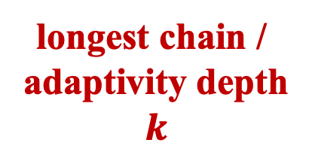
Adaptive Data Analysis
input
$${query}_{1} (X)$$
$$X$$
$${query}_{2}( ,X)$$
some queries rely on the results of other queries
longest chain /
adaptivity depth
$$k$$
$${query}_{3}( ,X)$$
…
$${query}_{k}( ,X)$$
output
$$R$$

Slide 6
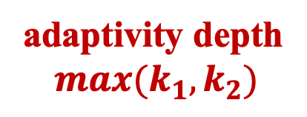







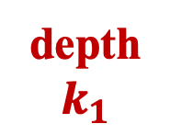

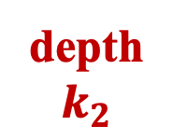
Adaptive Data Analysis
input
$${query}_{1}(X)$$
$${query}_{2}(X)$$
$${query}_{3}(X)$$
$$X$$
$${query}_{4}( ,X)$$
depth
$$k_{1}$$
$${query}_{5}( ,X)$$
depth
$$k_{2}$$
adaptivity depth
$$max(k_{1}, k_{2})$$
…
…
…
$${query}_{n}( ,X)$$
output
$$R$$

Slide 7
Generalization Error / Overfitting
fits bad
genl. error
fits well
Data / Population
analysis result
data set
X
sample
dependent queries over X
Data Analysis
Adaptivity in analysis will propagate the overfitting

Slide 8
Existing Methods – 1 Query Guarantee
Gaussian Mechanism
Laplace Mechanism
Threshold out
…
Guarantee generalization error
fits well
overfitting
Data / Population
analysis result
data set
X
Mechanisms
sample
multiple queries over X
query over X
Data Analysis
Guarantee will lose in multiple adaptive queries

Slide 9




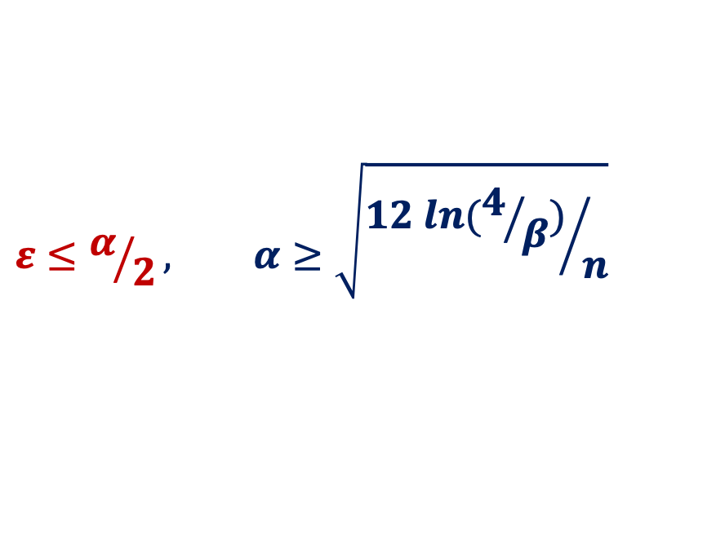

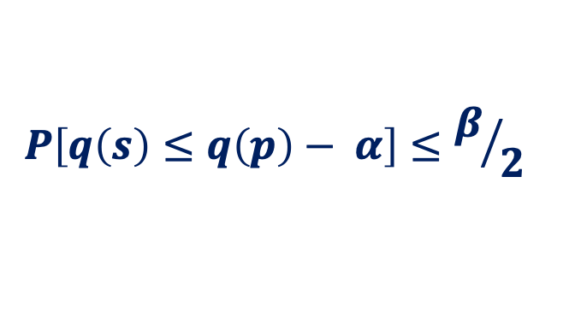
Theoritical Guarantee
Transfer Theorem – query $q$ is $ε−$differentially private
Sample
Distribution
$$S$$
$$P$$
$$q(S)$$
$$\sim$$
$$q(P)$$
$$P\left[q\left(s\right)≤q\left(p\right)− α\right]≤β/2$$
$$ε≤α/2, α≥\sqrt{{12 ln(4/β)}/n}$$

Slide 10
Preserving Statistical Validity in Adaptive Data Analysis
Transfer Theorem – query $q$ is $ε−$differentially private
Sample
Distribution
$$S$$
$$P$$
$$q(S)$$
$$\sim$$
$$q(P)$$
$$P\left[q\left(s\right)≤q\left(p\right)− α\right]≤β/2$$
$$ε≤α/2, α≥\sqrt{{12 ln(4/β)}/n}$$

Slide 11
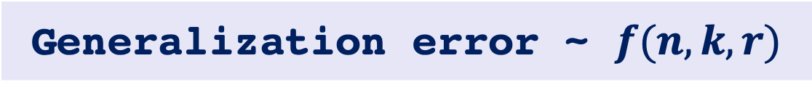
Consideration
Generalization error ~ $f(n, k, r)$
Formal verification
Theory proofs
?
Algorithm
implementation
program

Slide 12






Research Goals &. Challenge
input
$${query}_{1} (X)$$
$$X$$
$${query}_{2}( ,X)$$
adaptive query numbers
$${query}_{3}( ,X)$$
…
$${query}_{k}( ,X)$$
output
$$R$$

Slide 13
Where to apply mechanisms
Guarantee Generalization Error for
Multiple adaptive queries
How many mechanisms needed
Adaptivity Depth
Light or intense mechanism
…

Slide 14
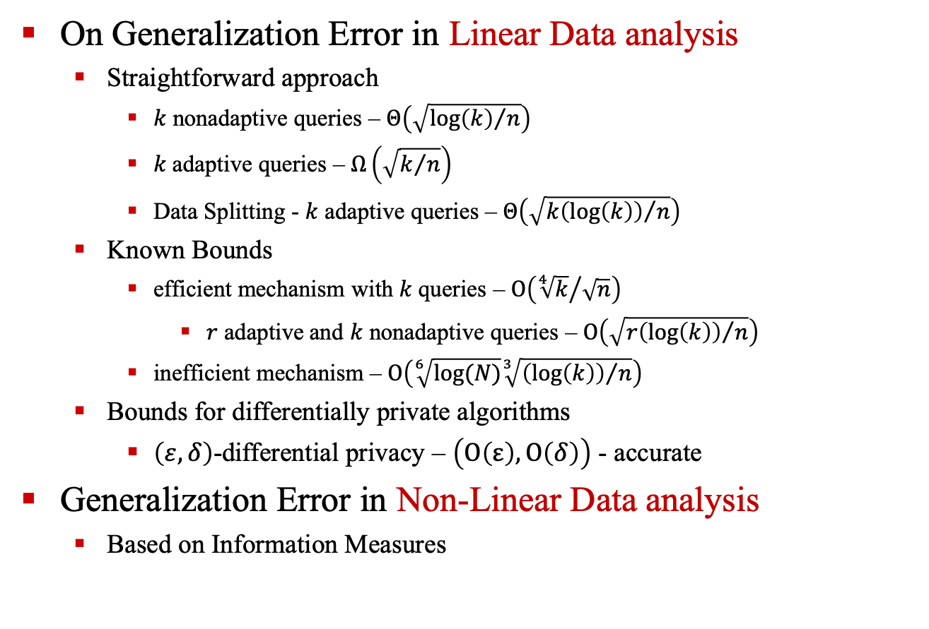
Information Privacy and Stability in Adaptive Data Analysis
On Generalization Error in Linear Data analysis
Straightforward approach
$k$ nonadaptive queries – $Θ\left(\sqrt{{\log\left(k\right)}/n}\right)$
$k$ adaptive queries – $Ω\left(\sqrt{k/n}\right)$
Data Splitting - $k$ adaptive queries – $Θ\left(\sqrt{{k\left(\log\left(k\right)\right)}/n}\right)$
Known Bounds
efficient mechanism with $k$ queries – $Ο\left({\sqrt[4]{k}}/{\sqrt{n}}\right)$
$r$ adaptive and $k$ nonadaptive queries – $Ο\left(\sqrt{{r\left(\log\left(k\right)\right)}/n}\right)$
inefficient mechanism – $Ο\left(\sqrt[6]{log⁡(N)}\sqrt[3]{{\left(\log\left(k\right)\right)}/n}\right)$
Bounds for differentially private algorithms
$\left(ε, δ\right)$-differential privacy – $\left(Ο\left(ε\right),Ο\left(δ\right)\right)$ - accurate
Generalization Error in Non-Linear Data analysis
Based on Information Measures

Slide 15
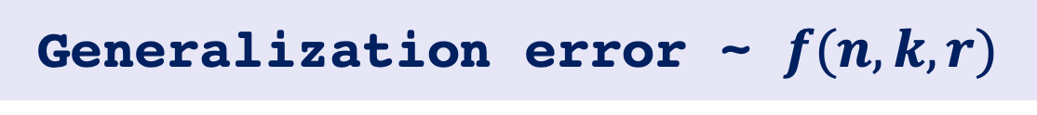
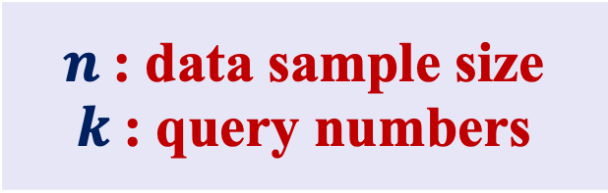
Research Goals &. Challenge
Generalization error ~ $f(n, k, r)$
Easily Track
Challenge
$n$: data sample size
$k$: query numbers
Adaptive query numbers

Slide 16
Full-Spectrum Adaptivity Analysis

Slide 17
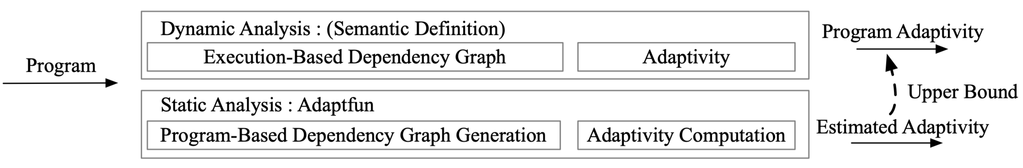
Full-Spectrum Adaptivity Analysis Framework

Slide 18
Challenge – I : Adaptive Data Analysis Formalization

Slide 19
Query-While Language Design

Slide 20
Challenge – II : Adaptivity Formalization

Slide 21
Execution-Based Adaptivity Analysis

Slide 22
Challenge – III : Adaptivity Estimation

Slide 23
Static Program Adaptivity Analysis

Slide 24
Further Works

Slide 25
Full-Spectrum Adaptivity Analysis Extension
Language Extension
Execution-Based Analysis Extension and Improvement
Static Analysis Extension and Improvement

Slide 26
Full-Spectrum Analysis on General Program’s Resource Cost

Slide 27
Towards Solving the CFL-Reachability Problem

Slide 28
Status and Plan

Slide 29
Status
The full-spectrum program adaptivity analysis is formalized into paper and submitted as a paper to POPL’2023.
It is also implemented and evaluated over three empirical data analysis algorithms and few designed examples.
Plan
September 05, 2022: Finish the improved execution-based dependency depth analysis and implementation
September 20, 2022: Finish Path Sensitive Reachability Bound Algorithm design and starting implementation
September 30, 2022: Finish Path Sensitive Reachability Bound Algorithm implementation and formalization.
October 15, 2022: Finish generalization on program resource cost analysis implementation and the reduction of CFL-Reachability problem.
November 05, 2022: Finish Path Sensitive Reachability Bound paper writing and Submit to PLDI 2023
November 20, 2022: Finish thesis
December 05, 2022: Defend

